Slide 1
Module A
Unit A4
Vocabulary
Language Functions
Speaking Activities
UTN FRVM Lic. Evangelina Cecchel - Lic. Bibiana Fernandez

Slide 2
Unit A4
Vocabulary: Curriculum Vitae
Job Interview
UTN FRVM Lic. Evangelina Cecchel - Lic. Bibiana Fernandez

Slide 3
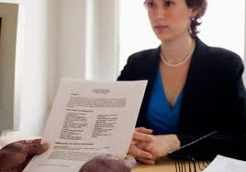
Job interviews
Resume
Work experience
Qualifications
Skills
Interests
Availability
References
UTN FRVM Lic. Evangelina Cecchel - Lic. Bibiana Fernandez

Slide 4
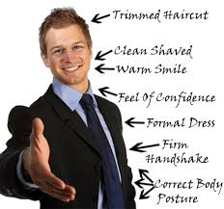
What is important for a job interview?
UTN FRVM Lic. Evangelina Cecchel - Lic. Bibiana Fernandez

